Slide 1



SS12 Team B1
Michael Hwang
Leslie Nguyen
David Hodge
Thomas Hauburger
Ryan Brown
Mentor: Ryan Ollerenshaw

Slide 2
What is Dojo?
A Javascript-based toolkit for building web pages.
Core - The base javascript libraries
Dijit - A widget library built on “Core” with accessibility functionality
DojoX - Visualizes data

Slide 3
Why Use Dojo?
Built-In accessibility features implementing the W3C WAI-ARIA
Adds full keyboard support to websites
Open Source
Lots of functionality
Customizable “Dijit” widgets

Slide 4
This is where we come in...
Our website is an accessible website builder... that builds accessible websites.
Lets disabled people build accessible pages
Leverages dojo, but hides its complexities
Personalized pages - Remember Geocities?
Simple Design
Attention to detail

Slide 5
Demo.

Slide 6
What is so great about [a]^2?
Issue | Solutions
Cognitive | specific color scheme
Hearing | closed captioning
Mobility | keyboard only navigation
Vision | Screen-reader High-contrast images

Slide 7
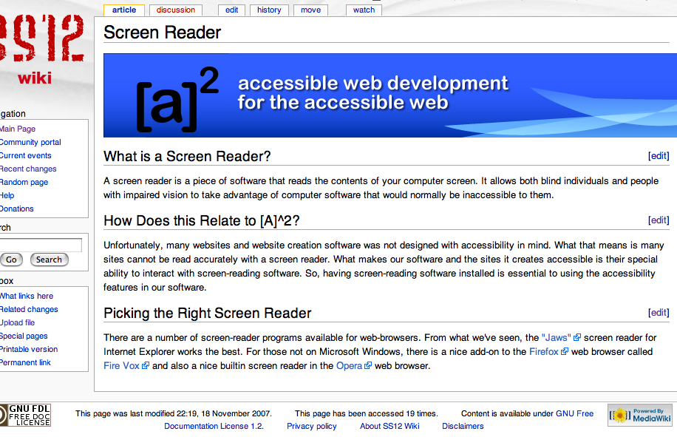
Documentation?
Absolutely! Check out our nice wiki.
http://ss12.info/wiki/index.php?title=Dojo_Toolkit_Team

Slide 8
Challenges
Dojo and its components have a REALLY steep learning curve
Dojo has scarce documentation
Maintaining accessibility as the priority without compromising functionality & design
Numerous screen-reader complexity and compatibility issues

Slide 9
Future Goals
Many possibilities for expansion
More flexibility in customizing the layout such as drag&drop or resizing
Save & publish multiple pages
Allow user to select themes for webpage

Slide 10
Contact and Q / A

